Slide 1
ARCHIMEDES OPTIMIZATION
ALGORITHM

Slide 2

ARCHIMEDES PRINCIPLE
Archimedes’ principle states that when an object is completely or partially immersed in a fluid, the fluid exerts an upward force on the object equal to weight of the fluid displaced by the object.
Assume that many objects immersed in the same fluid and each one tries to reach the equilibrium state. The immersed objects have different densities and volumes that cause different accelerations.
The object will be in the equilibrium state if the buoyant force Fb is equal to the object’s weight W.

Slide 3
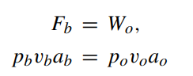
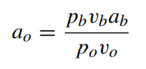
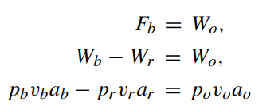
MATHEMATICAL FORMULATION
where p is the density, v is the volume, and a is the gravity or acceleration, subscripts b and o are for fluid and immersed object, respectively. This equation can be rearranged as:
If there is another force influenced on the object like collision with another neighbouring object (r), the equilibrium state will be:

Slide 4
GENERAL FLOW OF AOA
Initialize a random population, velocity, density, volume, acceleration
For t=1 to T (termination criteria)
For i=1 to P (population size)
1. UPDATE density and volume
2. UPDATE TF & d
3. UPDATE acceleration
4. NORMALISE acceleration
5. UPDATE POPULATION using those above updated parameters
END
END
PARAMETERS INVOLVED:
Density - [1 x P] array
Volume - [1 x P] array
Acceleration - [1 x P] array
TF (transfer operator)- Single variable
d (density decreasing factor)- Single variable

Slide 5
ENCODING
A sequence of tasks(following precedence relation) is used to represent the order of tasks to be performed.
A sequence of process alternatives representing numbers between 1-3 for each station representing,
1 - Only robot is allocated
2 - COBOT (robot + human) is allocated
3 - Only human is allocated
For example, a 11 task 4 stations encoding sequences looks like,
TASK PERMUTATION - 1 3 2 4 5 8 9 6 7 10 11
PROCESS ALTERNATIVES - 1 3 2 3

Slide 6
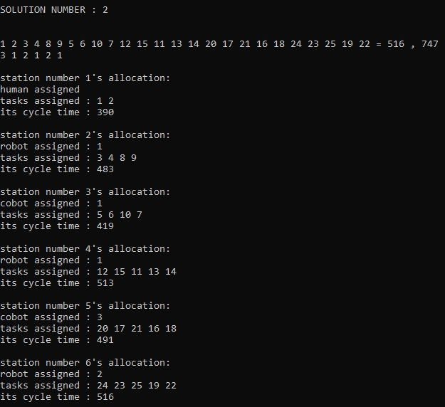
DECODING
Given a sequence of tasks and process alternatives, the allocation is found using consecutive method. For example, (25 tasks 6 stations)

Slide 7
UPDATION OF DENSITY AND VOLUME
Initially density and volume for each object of the population is generated randomly as a variable between [0-1]
Then for next iterations, the equation:
den(i)_t+1 = den(i)_t + r * (den_best - den(i)_t)
vol(i)_t+1 = vol(i)_t + r * (vol_best - vol(i)_t)
Where,
den(i)_t - density of i’th object in t’th iteration
den_best - density of best object in that population
vol(i)_t - density of i’th object in t’th iteration
vol_best - density of best object in that population
r - random number between (0-1)

Slide 8
2. UPDATION OF TF & d
This TF and d are the fine tuning parameters, which are calculated as the iteration progresses, rather than tuned by user. This makes this algorithm to be more randomized and exploit the search space.
TF_t = exp ( ( t - t_max ) / t_max )
d_t = exp ( ( t_max - t ) / t_max ) ) - ( t / t_max)
Where,
TF_t - transfer operator for t’th iteration
t_max - maximum number of iterations
d_t - density decreasing factor for t’th iteration

Slide 9
3. UPDATION OF ACCELERATION
Initially acceleration for each object of the population is generated randomly as a variable between [0-1]
Then for next iterations, the equation:
acc_i = ( (den_r + vol_r * acc_r) / (den_i * vol_i ) IF TF<=0.5
(exploration phase - when collision between object occurs)
acc_i = ( (den_best + vol_best * acc_best) / (den_i * vol_i ) OTHERWISE
(exploitation phase - when there is no collision between objects)
Where,
acc_i - acceleration of i’th object
den_best - density of best object in that population
den_r - density of r’th object where ‘r’ is generated randomly
vol_best - volume of best object in that population
vol_r - volume of r’th object where ‘r’ is generated randomly
acc_best - acceleration of best object in that population
acc_r - acceleration of r’th object where ‘r’ is generated randomly

Slide 10
4. NORMALISATION OF ACCELERATION
After calculating the acceleration of all the objects, it is normalised with the equation:
acc_i(norm) = ( u * ( acc_i - acc_min ) / ( acc_max - acc_min ) ) ) + l
Where,
acc_i(norm) - normalised acceleration of i’th object
acc_i - acceleration of i’th object in that population
acc_max - maximum acceleration in the population
acc_min - minimum acceleration in the population
u - 0.9 (range of normalisation)
l - 0.1 (range of normalisation)
The acc_i(norm) determines the percentage of step that each object will change.
If the object i is far away from global optimum, acceleration value will be high—meaning that the object will be in the exploration phase, otherwise, in exploitation phase.
This helps search agents move towards the global best solution and at the same time they move away from local solutions.

Slide 11
5. UPDATION OF POPULATION
IF TF<=0.5 - exploration phase (collision between objects)
x(i)_t+1 = x(i)_t + ( d * acc(i)_t+1 * ( x(r)_t - x(i)_t ) )
OTHERWISE - exploitation phase (no collision)
x(i)_t+1 = x(i)_t + ( F * d * acc(i)_t+1 * ( x_best - x(i)_t ) )
Where,
acc(i)_t - acceleration of i’th object in t’th iteration
x(i)_t - decision variable of i’th object in t’th iteration
x_best - best value of decision variable in the population
x(r)_t - decision variable of r’th object in t’th iteration where ‘r’ is generated randomly
d - density decreasing factor
F - Randomly generated, either -1 or +1

Slide 12
WHY THIS IS BETTER?
Has dedicated exploration and exploitation phases that creates a balance between exploration and exploitation.
Has no fine tuning parameters.
Any type of user with no knowledge of metaheuristic algorithms can use this algorithm and get results.
Faster compared to other algorithms as computations of simple math equations are faster.
Not much complexity involved in updation of population.
Larger search space is explored.
Easy to implement and hybridize with other algorithms.

